Slide 1
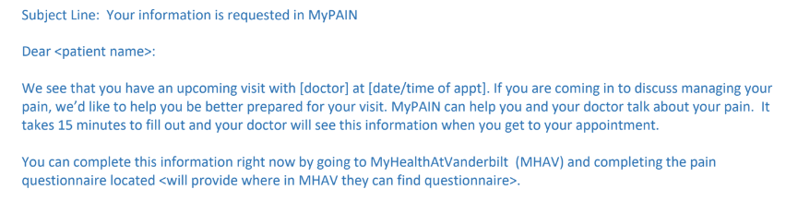
Before
After
Subject: Please complete MyPAIN survey before your visit
Dear [patient name],
We see that you have an upcoming visit with [doctor] at [date/time].
Do you want to discuss managing your pain at this visit? If so, please complete the following survey.
Your doctor will discuss your responses with you during your visit to determine the best approach to managing your pain.
It takes about 15 minutes.
Complete MyPAIN Survey
Thank You,
[sender]
Notes:
Development instructions: the bottom one is an example of the content of the MyPAIN invitation email.
//history//
Chris/Ramzi: I made the wording suggestions offered by Lori, with some tweaks.
Chris/Ramzi Responses 10/10: Agree with changes.
Notes: Formatted and reduced text for readability.
Feedback:
Alphora:
Chris:
Francisco: patients get a message saying there is a message. Need to ask if my chart alert message can be customized
Laura:
Lori: It may be too simplified. First bullet revised –Do you want to discuss managing your pain at this visit? If so, please complete the following survey. Also, the term ”shared decision making” is more of an industry term versus a lay persons term. Suggest revising bullet 2 – The doctor will discuss the information from the survey with you during the visit in order for you and your doctor determine the best solution for managing your pain
Ramzi:
Rob:

Slide 2
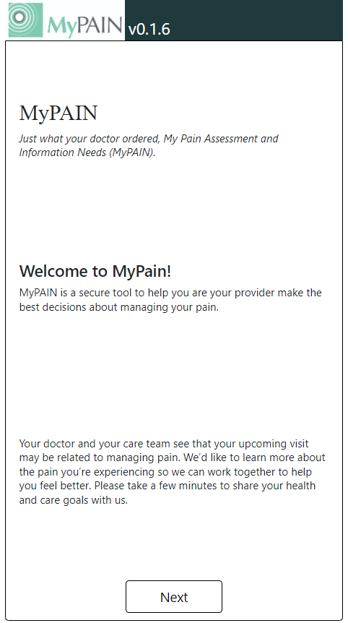
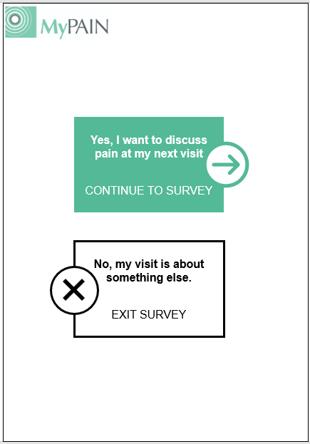
Insert Header
Before
After
NOTE: if you do not log off or close your browser after you complete the the survey, your information may be available to other people that use this computer for up to 1 hour.
Notes:
Development instructions: (1) Replace the introduction screen with this screener. Users who select ‘yes’ will proceed to survey. Users who select ‘no’ will exit survey and go back to MyChart messages. (2) use 12 pt. font wherever possible, 10pt at a minimum. If this presents problems for the layout, please reach out to discuss solutions.
//history//
10.25 – Chris added warning message as required by UF Health IT security as an administrative mitigation strategy to the 60-minute token timeout.
Chris/Ramzi: no changes from meeting
Chris/Ramzi Responses 10/10: Agree.
Notes: replaced introduction page with screening questions. The purpose of this is to provide a way for patients to quickly exit if they don’t need to discuss pain at their upcoming visit. This also provides some flexibility for a broader phenotype if necessary (too broad? Patients can exit out quickly).
Feedback:
Alphora: should be easy to do
Chris:
Francisco:
Laura:
Lori: Looks fine
Ramzi:
Rob:

Slide 3
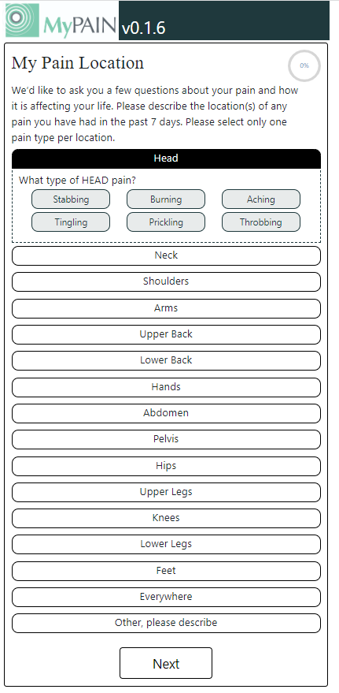


1 of 12
Where is the pain you would like to discuss?
Head
Head
What does it feel like?
Aching
Burning
Cramping
Punishing/Cruel
Stabbing
Throbbing
Neck
Shoulders
Elbows
Hands/Wrist
Back
Abdomen/Pelvis
Hips
Knees
Feet/Ankles
Foot
Everywhere
Other, please describe
Next
Notes:
Development instructions: (1) use the text, options, and order in the wireframe on the right. (2) allow users to select multiple pain types (aching, burning, etc.). (3) switch % progress circle to 1 of X pages as shown. (4) head to foot image is desired, but not required if too difficult to implement when options expanded.
//history//
10.24: Harle made updates to what does it feel like based on Hurley feedback. May need to adjust font or button size to accommodate “Punishing/Cruel”
Hurley final feedback: “what does it [pain] feel like? Looksl ike pulled some options from McGill Pain Inventory. There is not one set of words that fit perfectly – original mcgill has like 40 descripters – goal should be mix of words capturing a mix of nociceptive/arthritic and neuropathic pain. No perfect list without getting too long. “Punishing/Cruel” is a more affective. “Cramp” or “Cramping”. Rob says drop prickling and maybe replace. Drop “tingling”
Chris/Ramzi: (1) ok to focus on pain for visit instead of all pain in past 7 days? (2) feasibility of allowing users to select multiple types of pain (3) should we replace one of the types of pain with “other”? If so, which one?
Chris/Ramzi Responses 10/10:
(1) Yes Okay
(2) we should ask Alphora to do this even if moderate work (expect it won’t be terribly hard)
(3) I like including “Other, please describe” as shown in the current visual. Can we keep it along with all of the options? [maybe misunderstanding the question] Not sure if Chris had responded to this question yet – apologies if I missed it.
My initial reaction is that it is not necessary to add “Other” as an option to “what does it feel like”.
But maybe this is another question that we could seek input from a clinician on?
Notes: Showing what one of the options looks like expanded. (1) changed instructions to focus on the pain the patient wishes to discuss during the visit vs. any pain. During interviews, PCPs desired ways to focus on the important information so they can prioritize for visit. (2) reduced/combined pain location options with hopes of fitting all options above the fold so the user does not need to scroll. Eliminated options that providers did not mention as common areas of pain during interviews. (3) left align text. (4) since a clickable image of the body may be too difficult to implement, included a visual to convey the order of pain locations. (5) type of pain is sorted A-Z. Allow users to select multiple type options. (6) page 1 of 13 instead of % progress. Percentages are often misunderstood among general population.
Feedback:
Alphora: multi select not trivial, not difficult. Image maybe doable.
Chris:
Francisco:
Laura: 7 days is consistent with promis scale
Lori: Look the new layout.
Ramzi:
Rob:
Michelle-wants to click on more than one type of pain, maybe add other.

Slide 4
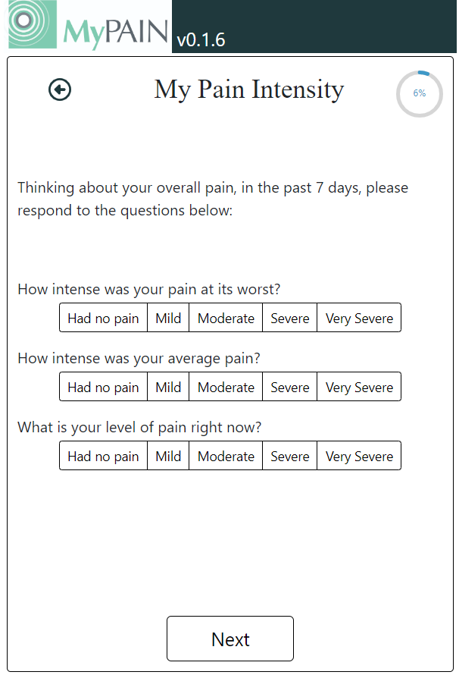

2 of 12
Over the past 7 days...
How intense was your pain at its worst?
How intense was your average pain?
What is your level of pain right now?
Back
Next
Notes:
Development instructions: (1) use text and bold formatting from wireframe on the right. (2) move back button to the bottom, but highlight ‘next’ so it is the main call to action.
//history//
Chris/Ramzi: (1) do we need permission from PROMIS to make changes? (2) I used the whole question and highlighted the different part, but the instructions are still different, ok?
Chris/Ramzi Responses 10/10:
No.
Okay.
Notes: (1) Changed instruction sentence to include the stem of the questions. This is an attempt to improve readability by reducing text and highlighting key words. (2) moved back button to bottom of screen.
Feedback:
Alphora:
Chris:
Cara: leave full sentence.
Francisco:
Laura: got permission from promis to use. Tradeoff of fidelity vs. ease of use. May need to run by promis developers.
Lori: I think you need to keep the full sentence for each pain measure. It took me a few seconds trying to figure our what “at its worst” was asking about.
Ramzi:
Rob:

Slide 5
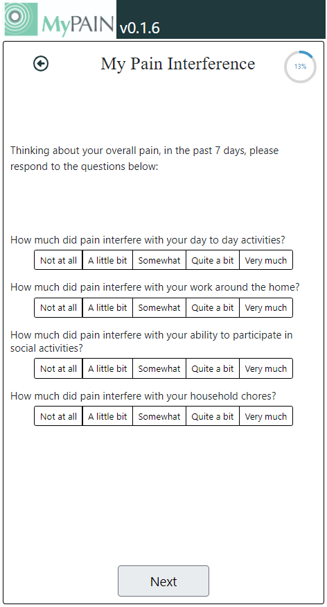

3 of 12
Over the past 7 days...
Insert Header
How much did pain interfere with your
day to day activities?
How much did pain interfere with your
work around the home?
How much did pain interfere with your
ability to participate in social activities?
How much did pain interfere with your
household chores?
Back
Next
Notes:
Development instructions: (1) use text, formatting, and bold as shown in the wireframe on the right.
//history//
Chris/Ramzi: same changes as previous slide
Chris/Ramzi Responses 10/10:
Same responses as slide 4
Notes: same as previous slide
Feedback:
Alphora:
Chris:
Francisco:
Laura:
Lori: Again, I would like the full sentence for each measure.
Ramzi:
Rob:

Slide 6
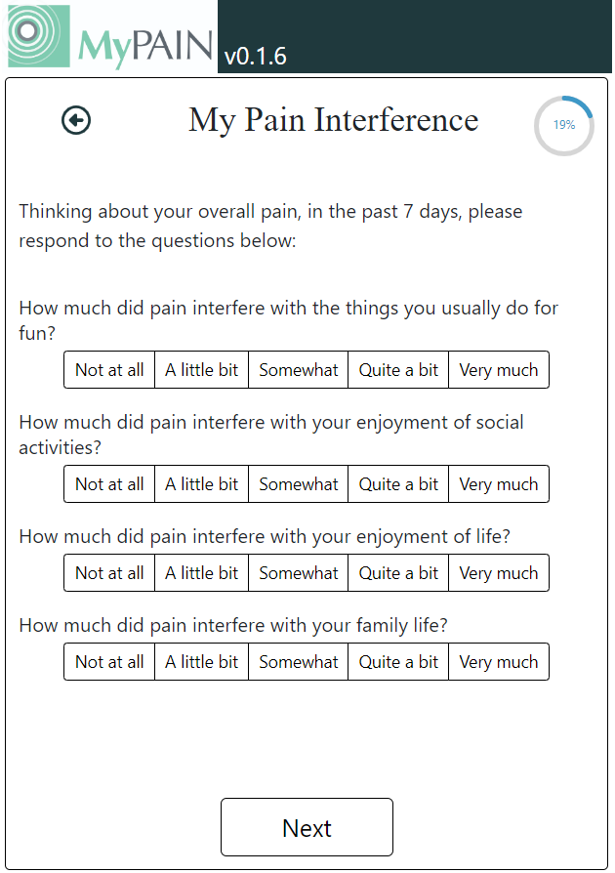
4 of 12
Over the past 7 days…
How much did pain interfere with
things you usually do for fun?
How much did pain interfere with your
enjoyment of social activities?
How much did pain interfere with your
enjoyment of life?
How much did pain interfere with your
family life?
Back
Next
Notes:
Development instructions: (1) use text, formatting, and bold as shown in the wireframe on the right.
//history//
Chris/Ramzi: same changes as previous slide
Chris/Ramzi Responses 10/10:
Same responses as slide 4
Notes: same as previous slide
Feedback:
Alphora:
Chris:
Francisco:
Laura:
Lori: Again, I would like the full sentence for each measure. It may seem repetitive but it keeps pain in the center of each question.
Ramzi:
Rob:

Slide 7
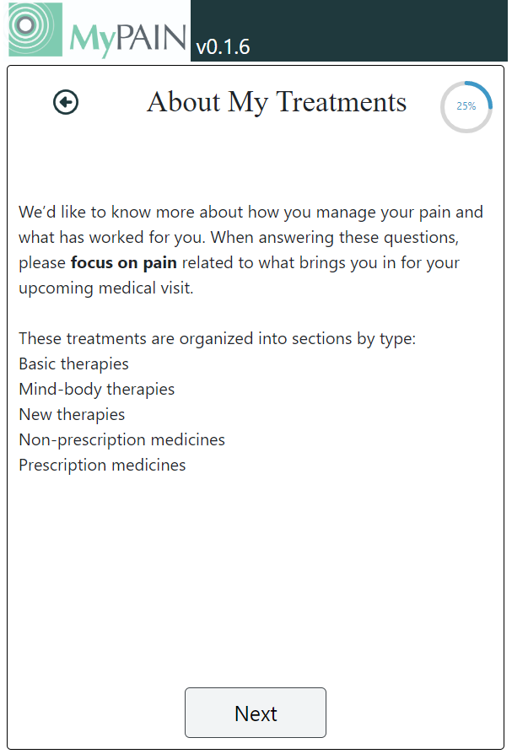
5 of 12
What medications have you tried for pain?
Over-the-counter pain reliever
(such as Advil, Aleve, Aspirin, Ibuprofen, Motrin, or Tylenol)
Prescription nonsteroidal anti-inflammatory
(such as Celebrex)
Prescription nerve pain medication
(such as Lyrica, Neurontin, or Cymbalta)
Prescription muscle relaxant
(such as Soma or Baclofen)
Prescription opioid medication
(such as Vicodin, hydrocodone, oxycodone, codeine, morphine, or tramadol)
Other: describe other medications you’ve tried for pain
I haven’t tried any medications for pain
Back
Next
Notes:
Development instructions: (1) remove intro page, (2) use text, formatting, and bold as shown in the wireframe on the right, (3) add an option for user to say they haven’t tried any of the listed options, (4) description of drop-down options is provided in slide 12.
//history//
11.2 – Julie shortened the intro text to make space for options.
10.24 – Chris updated medication names based on Hurley feedback and latest Julie iteration in xlsx. We talked out specifics of what patients tend to know in his experience, and it’s a mix of brand and generic. Also, removed fentanyl due to stigma, and limited use in noncancer pain by PCPs.
Chris/Ramzi: I added a preamble and the treatment type to ‘other’ and ‘none’. The actual treatments are pending feedback from clinicians.
Chris/Ramzi Responses 10/10:
Specify “oral medications” and remove “fentanyl” from “Prescription opioid” list of examples
Add “Lyrica” and “Neurontin” to the prescription non-opioid list
Add “muscle relaxants” to the prescription non-opioid list
Add “tramadol” to opioid list
Change “Ibuprofen” to “ibuprofen” – “i” should be lower case
should present this as a pointed question to our physician co-Is to review lists of generic/brand meds – anything missing from the list? What do you think about mixing generic/brand on the list? What will your patients think?
Notes: (1) recommend skipping this slide to streamline experience. Go straight to treatment options. (2) organized the options into different treatment categories: medications, topicals, specialists, psychological, interventions, integrative, lifestyle (3) added an option for none because patients did not know what to do next if they hadn’t tried any options.
Feedback:
Julie: Looking for suggestions on language that is brief and understandable by patients. Also looking for suggestions on categories (do they make sense to patients) and options (least number of options that are helpful to PCPs to know).
Alphora:
Chris: could we get preamble at the top of the first treatment screen. ‘so you doctor can best help yoy with your pain, tell us about the meds you’ve tried…”
Could just have an additional page for other treatments not on each page. How does user know other options are coming? Or, add “medications” to other description.
Cara: could keep first sentence, but agree with removing rest.
Francisco:
Laura:
Lori: I liked how you re-arranged the following treatment slides but I think there needs to be an intro to this section that describes the following questions about treatment.
Ramzi: would graphics or pictures help on transition slides.
Rob:
Michelle: remove intro screen, patients tend to pause there “what am I supposed to do here?” “What do you mean by new therapies or basic pages”.

Slide 8

6 of 12
What specialists have you seen for pain?
Chiropractor
Physical therapist
Pain management specialist
Orthopedist
Psychologist or counselor
(such as for group or individual therapy, acceptance & commitment therapy, cognitive behavior therapy)
Integrative medicine specialist
Other: describe other specialists you have seen for pain (such as neurologist, spine doctor rheumatologist, or physiatrist)
I haven’t seen any specialists for pain
Back
Next
Notes:
Development instructions: (1) use text, formatting, and bold as shown in the wireframe on the right, (2) add an option for user to say they haven’t tried any of the listed options, (3) description of drop-down options is provided in slide 12.
//history//
11.2 – Julie added spine doc as an example under ‘other’ per Rob’s feedback.
10.25 – Chris updated based on Julie spreadsheet and some feedback from Hurley
10.24 – removed sleep based on feedback from Hurley (typically not ordered for pain).
Chris/Ramzi: we did not discuss the fact that I removed the timeframe of 6 months. Are you ok with this change?
Chris/Ramzi Responses 10/10:
Ok to remove 6 months timeframe
Remove all caps for ”Bengay, Tiger Balm, Biofreeze”
Change “creme” to “cream”
Notes: (1) removed timeframe of past 6 months because Pain Manager does not track this over time (e.g., providers cannot see what patients tried over six months ago). This way, providers will know if the patient tried physical therapy 9 months ago. Additionally, users do not reliably read instructions and may answer assuming the timeline is ‘ever’. The reason I kept the timeline in the previous slides is because the pain and interference questions come from a validated instrument (PROMIS).
Feedback:
Alphora:
Chris:
Francisco:
Laura:
Lori:
Ramzi:
Rob:

Slide 9
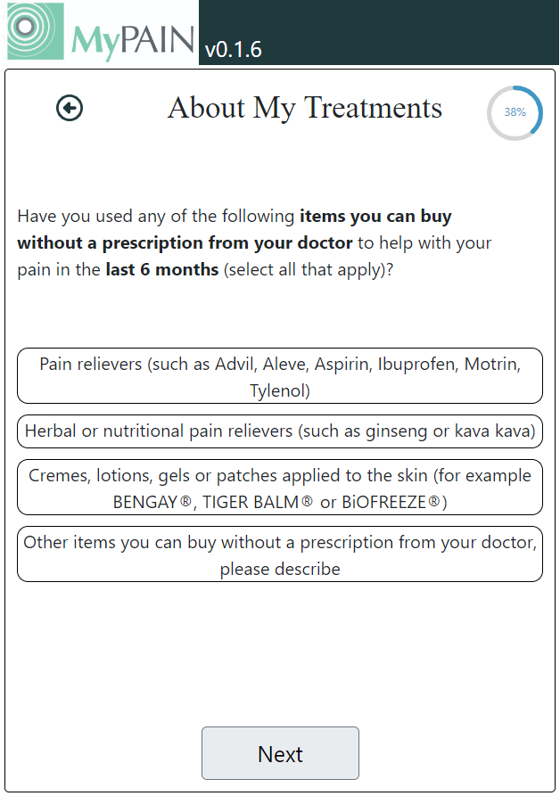
7 of 12
What procedures or physical treatments have you tried for pain?
Surgery
Injection
(such as a shot to relieve inflammation)
Massage
Dry needling or cupping
Acupuncture
Other: describe other procedures or physical treatments you've tried for pain
I haven’t tried any procedures or physical treatments for pain
Back
Next
Notes:
Development instructions: (1) use text, formatting, and bold as shown in the wireframe on the right, (2) add an option for user to say they haven’t tried any of the listed options, (3) description of drop-down options is provided in slide 12.
//history//
10.25 Removed sleep positioners based on Hurley feedback
Chris/Ramzi: same comments as other treatment screens
Chris/Ramzi Responses 10/10:
See prior slide comments
Notes: see previous
Feedback:
Alphora:
Chris:
Francisco:
Laura:
Lori:
Ramzi:
Rob:

Slide 10
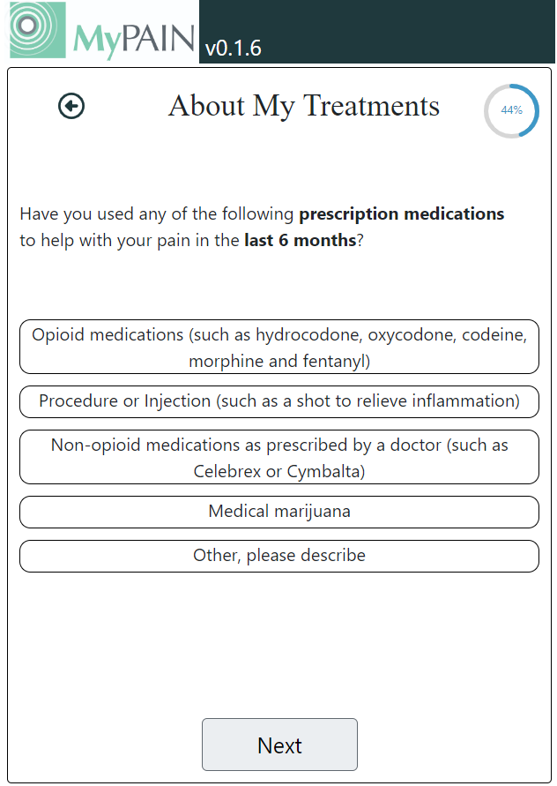
8 of 12
What topical treatments or devices have you tried for pain?
Heat and/or ice
Topical medications
(such as creams, lotions, gel, patches, Bengay, Tiger Balm, Salonpas, Biofreeze, or Lidoderm)
TENs unit device
Bracing
Other: describe other topical treatments or devices you've tried for pain
I haven’t tried any topical treatments or devices for pain
Back
Next
Notes:
Development instructions: (1) use text, formatting, and bold as shown in the wireframe on the right, (2) add an option for user to say they haven’t tried any of the listed options, (3) description of drop-down options is provided in slide 12.
//history//
11.2 – Julie added bracing as an option per feedback from Rob
10.24 – Chris added Salonpas after discussion with Hurley
Chris/Ramzi: same comments as other treatment screens
Chris/Ramzi Responses 10/10:
Change “mindfulness-base training” to “mindfulness-based therapy”
Combine the first 3 categories into 1 category: “Group or individual therapy (such as, acceptance and commitment therapy or cognitive behavioral therapy)”
Notes: see previous
Feedback:
Alphora:
Chris:
Francisco:
Laura:
Lori:
Ramzi:
Rob:

Slide 11
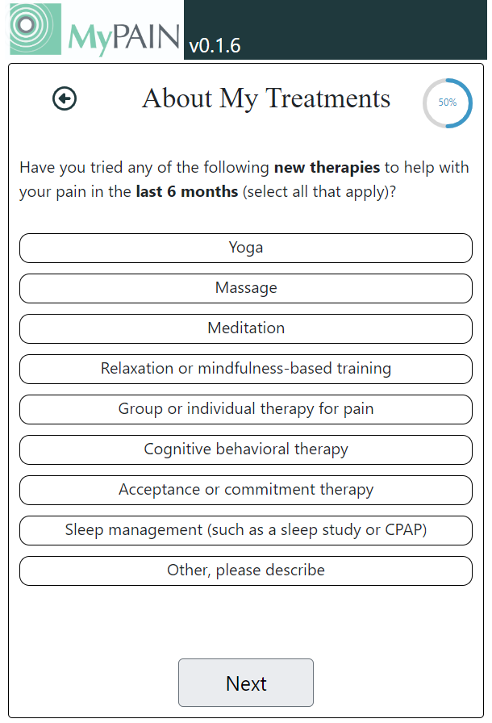
9 of 12
What lifestyle changes have you tried for pain?
Exercises or stretching
(such as walking, yoga, water aerobics)
Diet or hydration
(such as an anti-inflammatory diet or drinking enough water)
Weight loss
Stress reduction
(such as relaxation, meditation, mindfulness, laughter)
Posture or ergonomics
Other: describe other lifestyle changes you've tried for pain
I haven’t tried any lifestyle changes for pain
Back
Next
Notes:
Development instructions: (1) use text, formatting, and bold as shown in the wireframe on the right, (2) add an option for user to say they haven’t tried any of the listed options, (3) description of drop-down options is provided in slide 12.
//history//
11.2 – Julie combined diet and hydration and added posture/ergonomics because these were prominent treatments in the resources (UofM and PAMI).
Chris 10.25
Was not able to talk to Rob about this list.I am comfortable with taking Julie’s list pasted here in the table and using that. Also, please confirm that the “other” box should allow users to enter other treatments free-text. This needs to be made clear to Alphora.
Chris/Ramzi: forgot to discuss that I changed the answer options from never, sometimes, and always to a 4-point scale. What do you think of this?
Chris/Ramzi Responses 10/10:
Does “Did it work?” appear for other treatment types (on previous slides)? It is only shown on this slide, but we wanted to confirm whether it also appears on prior pages.
Chris/Ramzi: same comments as other treatment screens
Chris/Ramzi Responses 10/10:
See prior slide comments
Notes: see previous
Feedback:
Alphora:
Chris:
Francisco:
Laura:
Lori:
Ramzi:
Rob:

Slide 12
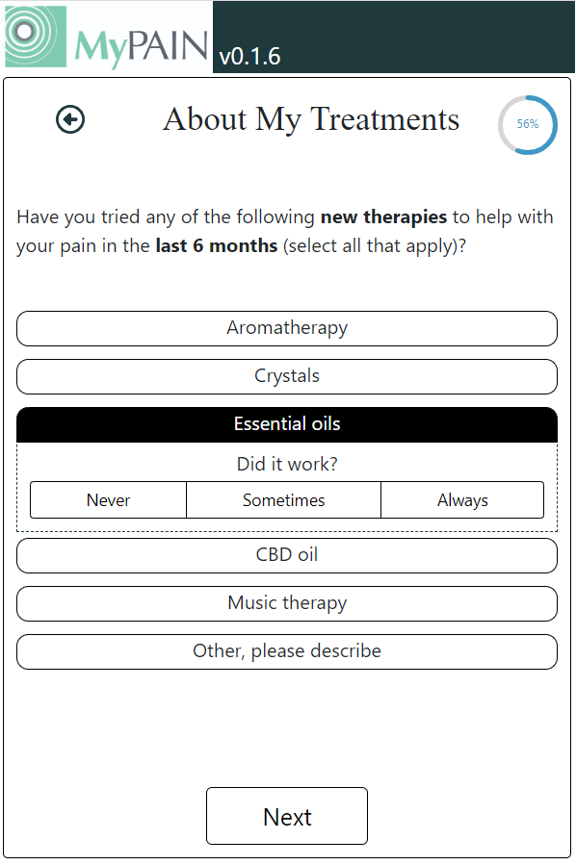
10 of 12
What alternative treatments have you tried for pain?
Herbal treatments or supplements
(such as ginseng or kava kava)
Aromatherapy
CBD oil
Did it work?
Not at all
Slightly
Moderately
Greatly
Marijuana used for medical purposes
Other: describe other alternative treatments you've tried for pain
I haven’t tried any alternative treatments for pain
Back
Next
Notes:
Development instructions: (1) use text, formatting, and bold as shown in the wireframe on the right, (2) add an option for user to say they haven’t tried any of the listed options, (3) “did it work” drop down appears for all treatments across pages, except the “other” button which allows the user to enter free form text.
//history//
Chris 10.25
Was not able to talk to Rob about this list.
I am comfortable with taking Julie’s list pasted here in the table and using that.
Chris/Ramzi: forgot to discuss that I changed the answer options from never, sometimes, and always to a 4-point scale. What do you think of this?
Chris/Ramzi Responses 10/10:
Does “Did it work?” appear for other treatment types (on previous slides)? It is only shown on this slide, but we wanted to confirm whether it also appears on prior pages.
Notes: (1) showing what one of the options looks expanded. Suggest changing the answer options to a 4-point scale. We noticed that users tended to score almost every treatment as “sometimes”. By eliminating the middle option, it might encourage a more varied response which might be more helpful information to providers. Note, it is possible for a treatment to make something worse, which we do not address here but could be lumped with ‘not at all’.
Feedback:
Julie: looking for feedback on what type of scale is most helpful to providers
Alphora:
Chris:
Francisco:
Laura:
Lori:
Ramzi:
Rob:

Slide 13

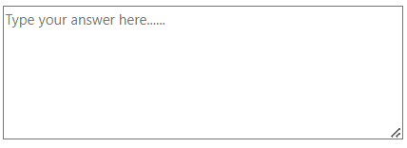
11 of 12
Activity Goals: what goals do you have for your daily activities?
Examples: I want to walk my dog daily. I want to continue to play guitar with my son.
Back
Next
Notes:
Development instructions: (1) use text and formatting in wireframe on the right.
//history//
Chris/Ramzi: I tweaked the preamble a bit.
Chris/Ramzi Responses 10/10:
Suggest: ”Activity Goals: What goals do you have for your daily activities?” … [keep examples as is]
Ramzi: Ok with Chris suggestion
Notes: Re-defined activity goals and examples.
Feedback:
Alphora:
Chris: despite?
Cara: open to more than activities.
Francisco: “doing” instead of despite
Laura:
Lori:
Ramzi:
Rob:
What activities and goals are important to you to continue doing?

Slide 14

12 of 12
Activity Barriers: what are the biggest barriers to achieving your daily activity goals?
Example: I have a lot of stress from work that makes my pain worse.
Back
Submit
Notes:
Development instructions: (1) use text and formatting in wireframe on the right.
//history//
Chris/Ramzi: no changes from meeting
Chris/Ramzi Responses 10/10:
Suggest: ”Activity Barriers: What are the biggest barriers to achieving your daily activity goals?” [keep examples as is]
Ramzi: ok with Chris suggestion
Notes: reformatted text to separate instructions from example.
Feedback:
Alphora:
Chris:
Francisco:
Laura: the shared decision making expert and patients like broader questions to get better/more information. But have a specific example. Data from field: might be a wide range of responses.
Lori:
Ramzi:
Rob:

Slide 15
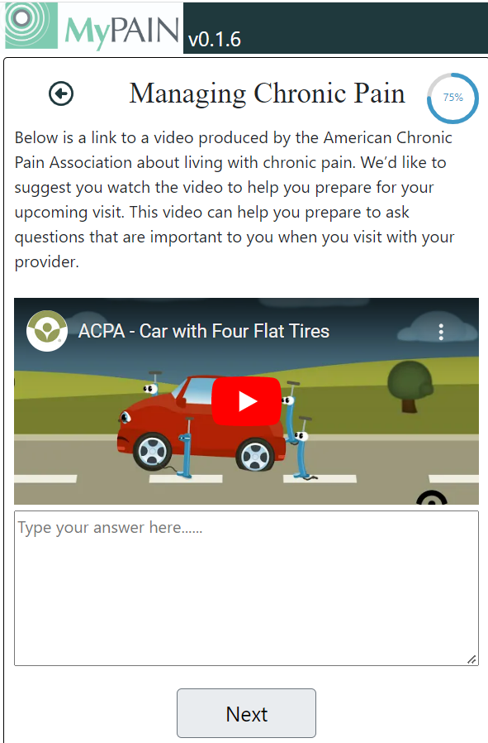
Notes:
Development instructions: (1) remove this page
//history//
Chris/Ramzi: we need to decide where the resources will go (1) part of mypain, but after patients submit, (2) followup email or this EMMI thing, (3) some link/QR code from mypain? My preference is email because it also gives us a chance to send them a summary of their answers, which also provides them a record of their progress.
Chris/Ramzi Responses 10/10:
- We recommend placing the links to resources (UMich & PAMI sites) on a page after the patients submit and as a follow up email.
Chris preliminary responses 10.7
Notes: Recommend removing this page and including resources in a follow-up email. Patients do not have much time to review these resources in the context of completing the survey. This also provides flexibility to add additional resources as suggested by the patient focus group.
Feedback:
Alphora: potential security issues, complicated but doable. Could put both at end and open a new window?
Chris: Is it a pdf with links?
Cara: could have email and paper resources to hand out, challenge is that providers moving away from paper, maybe QR code?
If you would like additional resources enter email? Here’s a link to page with resources (list them all).
Francisco: at end, opportunity to view resources at the end, maybe save a qr code or link to save on their phone.
Laura:
Lori: I agree – this should be in a follow-up email so they can take their time viewing resources and have them handy to review multiple times.
Ramzi:
Rob:
Michelle: patients have struggled, video expanded and user couldn’t get back on text box and gave up.

Slide 16
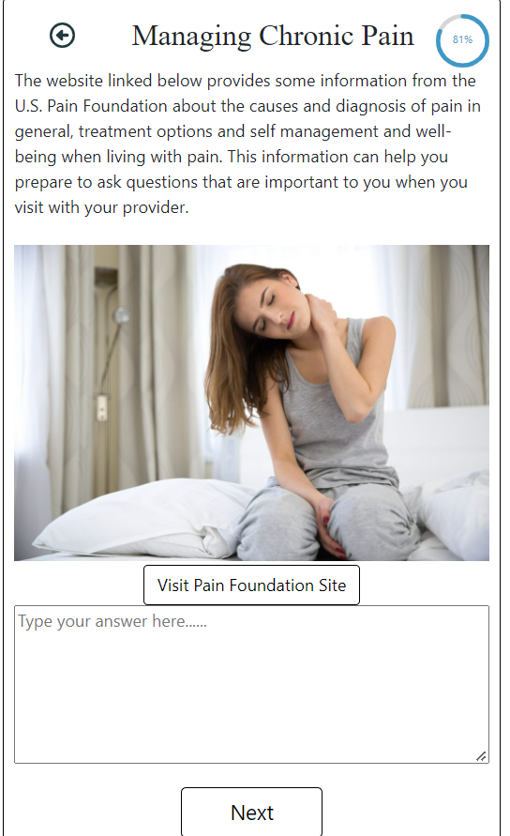
Notes:
Development instructions: (1) remove this page
//history//
Chris/Ramzi: same as previous slide
Chris/Ramzi Responses 10/10:
- See prior slide comment – can the two resource links be combined in a single page without questions for patient AND supplied afterward via email. If supplied in a single page, we should also explain that the same links will be sent via MyChart message so they can be kept and looked at later.
Notes: Recommend removing this page and including resources in a follow-up email.
Feedback:
Alphora:
Chris:
Francisco:
Laura:
Lori: Agree
Ramzi:
Rob:

Slide 17
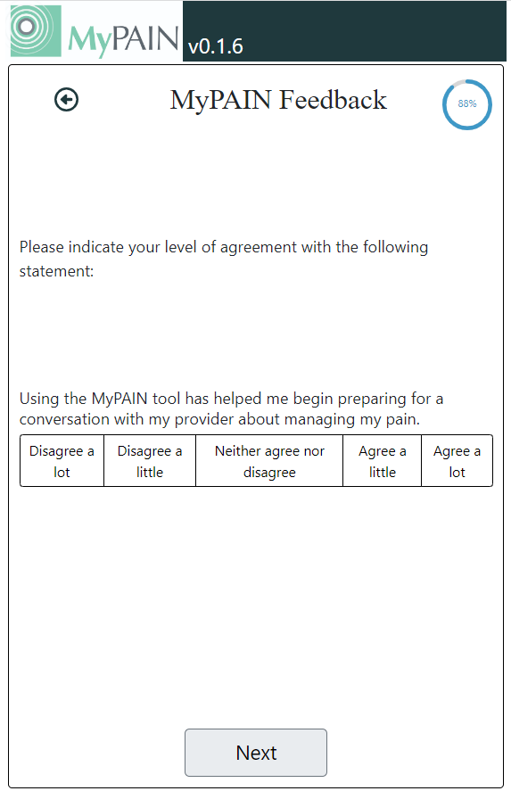
Notes:
Development instructions: (1) remove this page
//history//
Chris/Ramzi: need to make a decision if this is valuable to keep
Chris/Ramzi Responses 10/10:
Recommend to remove this question.
Ramzi: agree.
Notes: Recommend removing if there is not a clear need for this in the UF implementation.
Feedback:
Alphora:
Chris: look in context of evaluation plan
Francisco:
Laura: people did respond saying they found it helpful – was important to their team
Lori: I want to keep it since it will help tell us if the MyPAIN tool is helpful to them
Ramzi:
Rob:

Slide 18
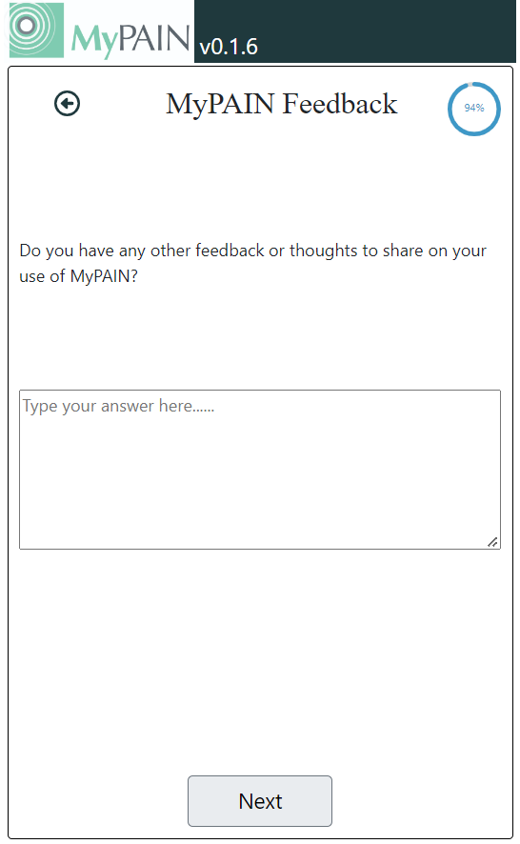
Notes:
Development instructions: (1) remove this page
//history//
Chris/Ramzi: need to make a decision if this is valuable to keep
Chris/Ramzi Responses 10/10:
Recommend removing this question.
Notes: Recommend removing if there is not a clear need for this in the UF implementation.
Feedback:
Alphora:
Chris:
Cara: maybe just include one? One patient said they didn’t know how to answer because they hadn’t used the tool much.
Francisco:
Laura:
Lori: I agree
Ramzi:
Rob:

Slide 19
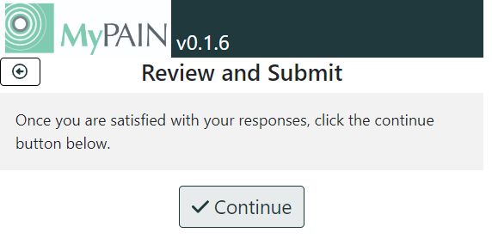
Notes:
Development instructions: (1) remove this page; responses will still be collected but displayed at the end and delivered via MyChart message.
//history//
Chris/Ramzi: I feel strongly that we should remove this. Nobody really wants to review their responses to something non-critical that they are going to discuss with their doctor anyway. This is not like entering your bank account number. But, I do think there is value in sending an email with the responses because they provide a record of progress over time.
Chris/Ramzi Responses 10/10:
Agree to remove.
Notes: There are no responses here because I made no selections while taking screenshots. Recommend removing this page and including a copy of the patient’s answers in a follow-up email.
Feedback:
Alphora:
Chris:
Francisco:
Laura: have no option to review what they submitted if remove this page.
Lori:
Ramzi:
Rob:

Slide 20
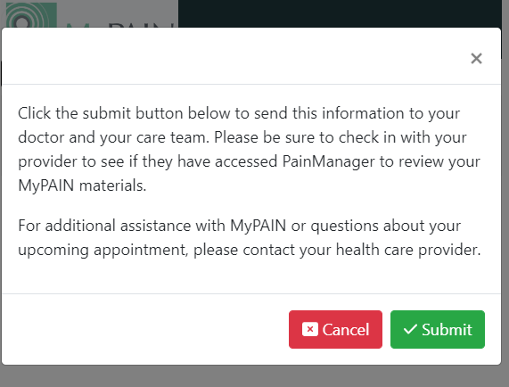
Notes:
Development instructions: (1) remove this page; submit occurs on “activity barriers page”.
//history//
Chris/Ramzi: no changes from meeting
Chris/Ramzi Responses 10/10:
Agree with removing
Notes: Recommend removing this extra step. Final submit can be found on slide 16.
Feedback:
Alphora:
Chris:
Francisco:
Laura:
Lori:
Ramzi:
Rob:

Slide 21
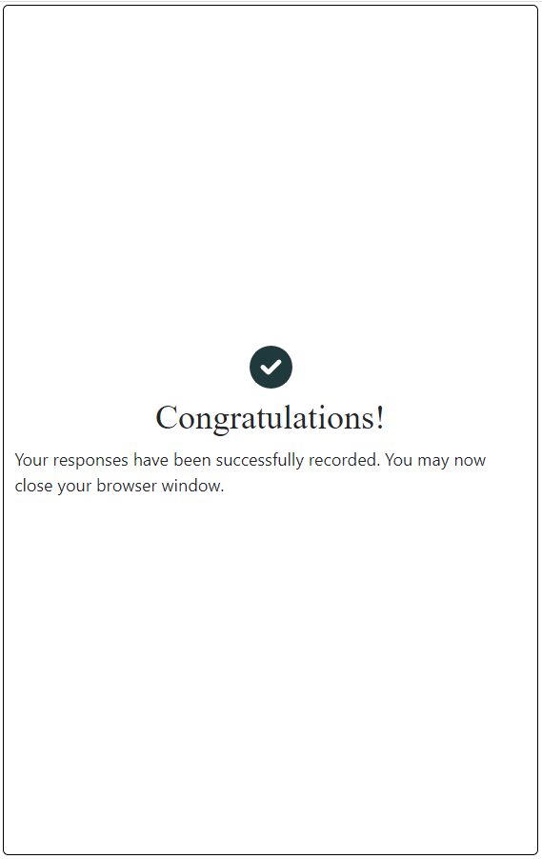



Thank You!
Your responses have been sent to your doctor.
Remind your doctor to review the information during your visit.
Lookout for a MyUFHealth message with pain resources and a copy of your responses.
You may close this browser window.
Notes:
Development instructions: (1) use text and formatting from wireframe on right. Note: bullet 3 may not be relevant if email cannot be sent.
//history//
Chris/Ramzi: we will need to adjust this depending on decision about where resources go.
Chris/Ramzi Responses 10/10:
- Agree, just need to make wording consistent with resource approach (see prior slides)
Notes: Added some extra messages to the final screen.
Feedback:
Alphora:
Chris:
Cara: could transition to resources.
Francisco:
Laura:
Lori: Agree
Ramzi:
Rob:

Slide 22
HELPFUL PAIN RESOURCES
The following websites may have information that could help you with your chronic pain.
Pain Resources from University of Florida
Short videos with helpful tips for managing pain, including alternative therapies.
Pain Guide from University of Michigan
Comprehensive and up-to-date resource for evidence-based approaches to chronic pain.
GO
GO
Back
Notes:
Development instructions: Below are the URLs for the links:
https://pami.emergency.med.jax.ufl.edu/resources/pami-educational-pain-videos/
https://painguide.com/

Slide 23
YOUR MYPAIN RESPONSES
Question | Answer
Low back: what does it feel like? | aching
Back
Notes:
Development instructions: formatting of this page is very similar to current MyPAIN (I’m just showing one here). I recommend removing the full question before the table (it’s omitted here) and putting the headers (question & answer) in grey instead of the user’s response.

Slide 24
Subject: MyPAIN Resources & Responses
Dear [patient name]
Thank you for completing MyPAIN.
Below is a summary of your responses.
You doctor has your responses, but you may want to remind them during your visit.
Chronic Pain Resources
Pain Resources from University of Florida Short videos with helpful tips for managing pain, including alternative therapies.
Pain Guide from University of Michigan Comprehensive and up-to-date resource for evidence-based approaches to chronic pain.
MyPAIN Responses (your copy)
Question | Answer
Low back: what does it feel like? | aching
Notes:
Development instructions: This is an example of the content of the MyPAIN follow-up email.
//history//
Chris/Ramzi: we did not get a chance to review this follow-up email. Suggested resources are below and I endorse adding the U of Michigan pain guide.
Chris/Ramzi Responses 10/10:
We recommend listing the UMich and PAMI sites only in this order (the 4 flat tires video is included in PAMI site)
1) U Michigan
2) PAMI https://pami.emergency.med.jax.ufl.edu/resources/pami-educational-pain-videos/
Notes: Example follow-up email to patients. We have a list of resources that the patients liked below:
PAMI “manage chronic pain” video
PAMI “prevent & relieve back pain” video
U.S. Pain Foundation website
PAMI “pain medication safety” video
PAMI “complementary therapies” video
VeryWellHealth article on diet & chronic pain
ACPA “4 flat tires” video
Another option (not reviewed by patients) is the U of Michigan pain guide.
https://painguide.com/pain-care/self-care/
Feedback:
Alphora:
Chris:
Francisco:
Laura:
Lori:
Ramzi:
Rob:

